Slide 1
Management System Membership
How to Renew, Edit or Check
Membership Status

Slide 2
First, a Couple of Basics

Slide 3
www.wpaflys.org
The Renewal Process
Click Here

Slide 4
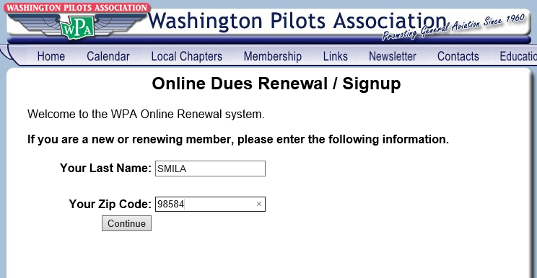
Member Credit Card Online Renewal Screen
The Easiest Way to Sign Up or Renew

Slide 5
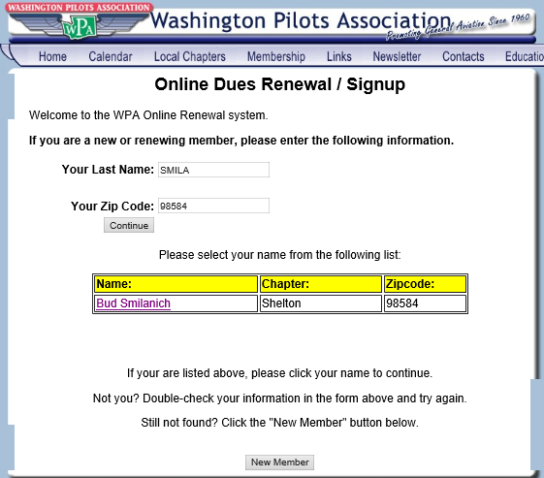
This Helps Avoid Duplicate Memberships for the Same Person
NOTE!
If The Member DOES NOT Appear,
Click “New Member” Box

Slide 6
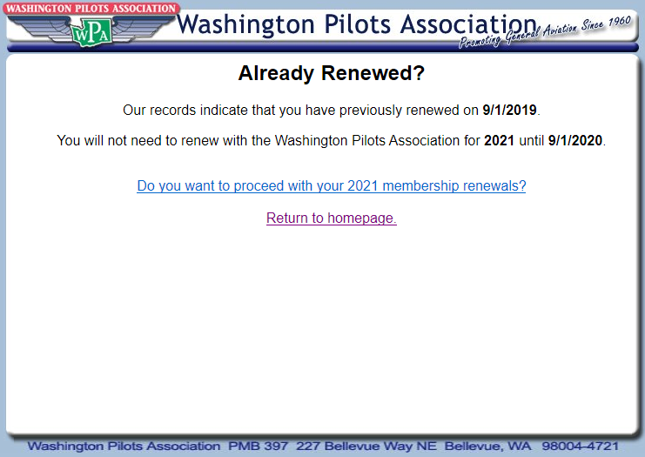
NOTE! Next Year (2021) Begins September 1, 2020
Click Here if You Really Want to Sign Up For the Next Year
Member is Already Current. If The Member Elects to Proceed, They
Will Be Able to Update Their Member Information and
Pay By Credit Card BUT Not Change Chapters

Slide 7
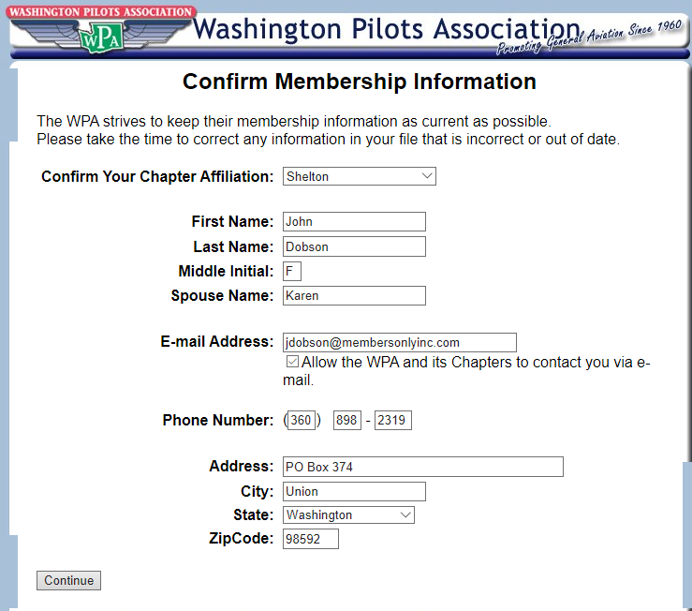
NOTE! This is THE ONLY Time
a Member Can Change His
Chapter Affiliation

Slide 8
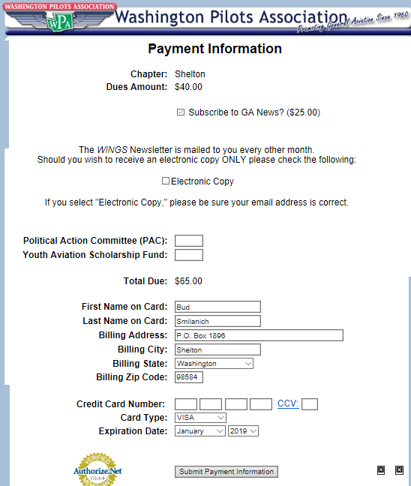
Optional Member
Benefit
Check Here if You Want
Electronic ONLY Copy of Wings
PAC Contributions (Optional)
YASF Contributions (Optional)
Default is VISA.
Be Sure to Change if MC
Complete CC Transaction
& Hit “Submit Payment” Button

Slide 9
Membership Functions
Search for a Chapter Member
Edit Member Information (Address and email
Need to be Kept Current)
Verify Member Payment Status including YASF Donations, PAC Contributions and GA News Subscriptions
Verify Payment Date and if by Credit Card, Cash or Check

Slide 10
You Must Be Logged In to Proceed
Click Here

Slide 11
You Must Be Logged In

Slide 12
The WPA Management System

Slide 13
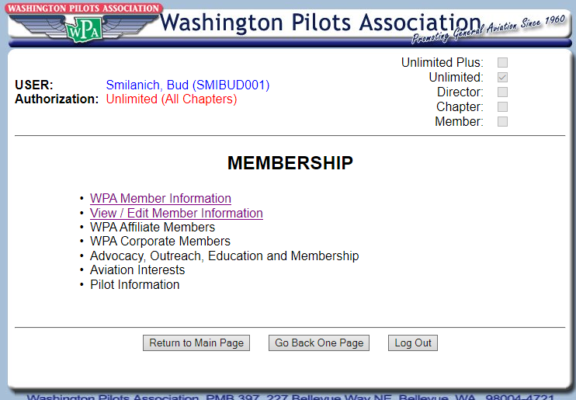
Management System Membership Functions
Membership
Main Menu
The First 2 Options Will Tell You Everything You Need to Know

Slide 14
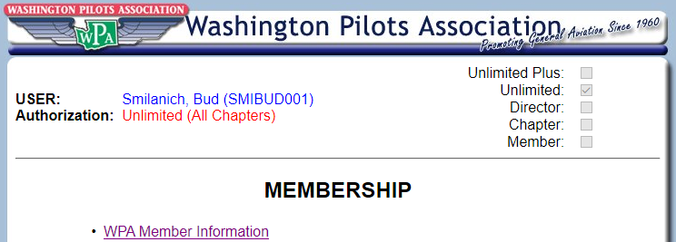
Here’s Where You’ll Find All
Members Information

Slide 15
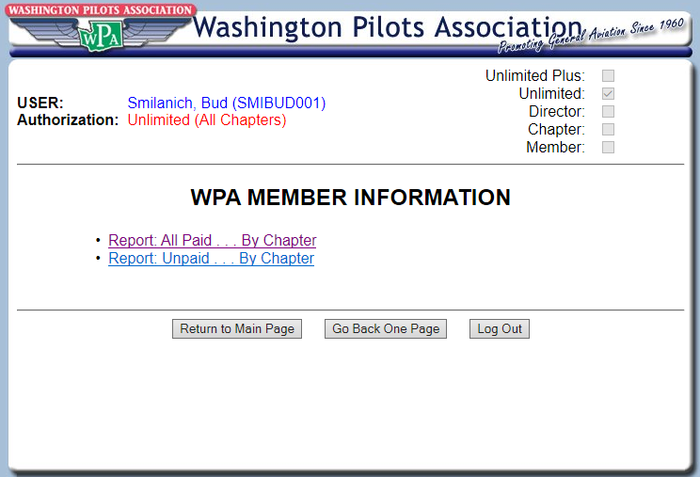
All Members Paid by Chapter
For Any Given Membership Year

Slide 16
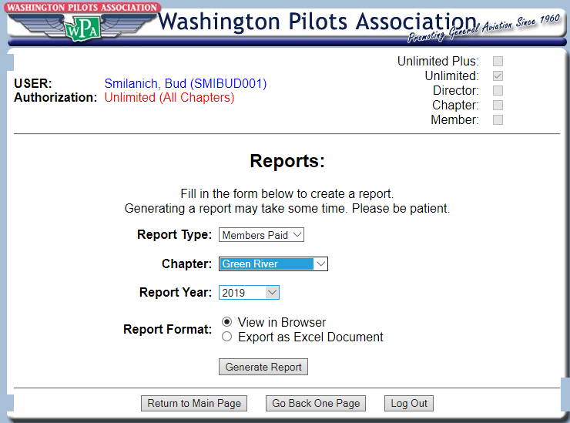
Select Your Chapter
From Drop Down Menu
Select View or Excel
Spreadsheet Download

Slide 17
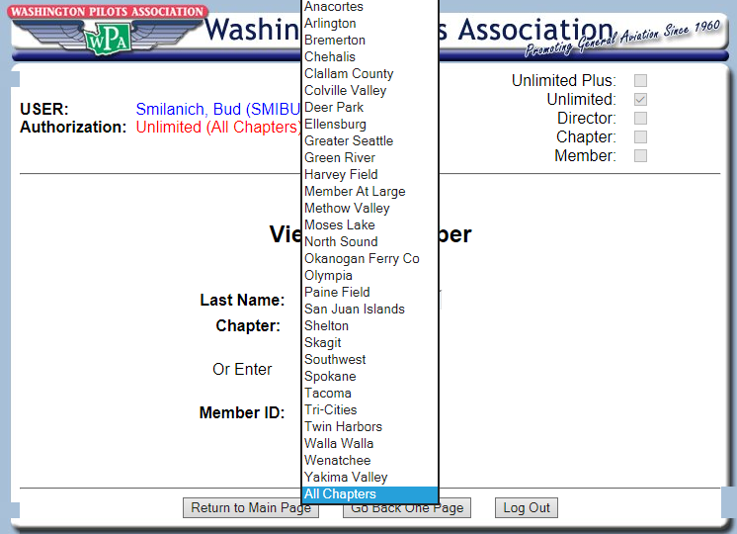

Slide 18
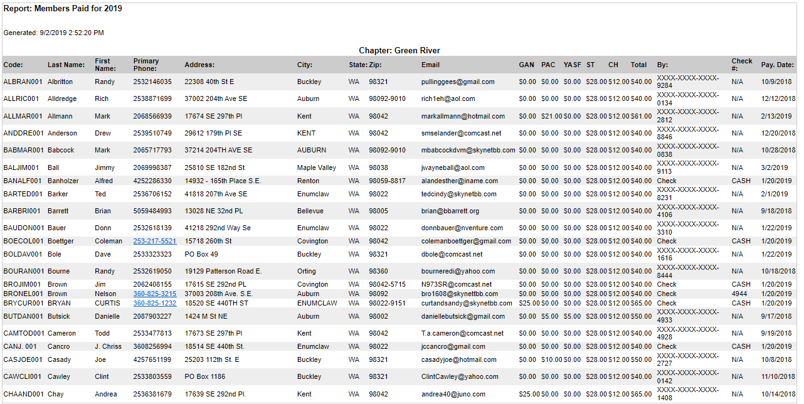
Note Alphabetical Order

Slide 19
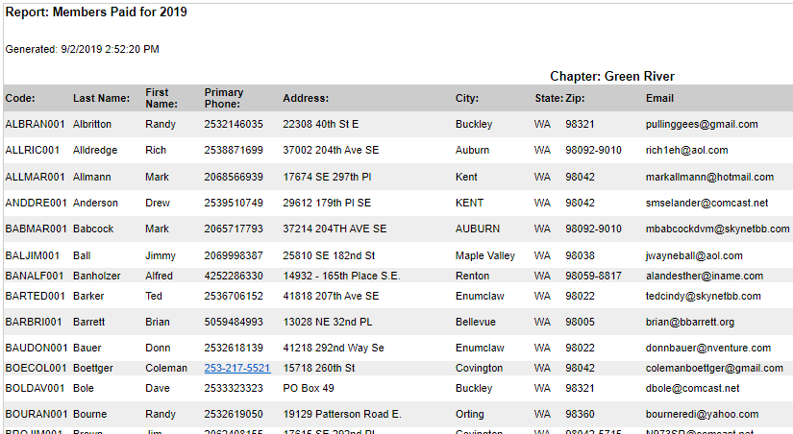
Left Side - Member Information

Slide 20
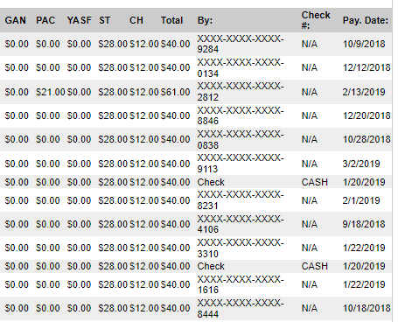
Right Side - Transaction Details
Note. Credit Card,
Check No. or CASH

Slide 21
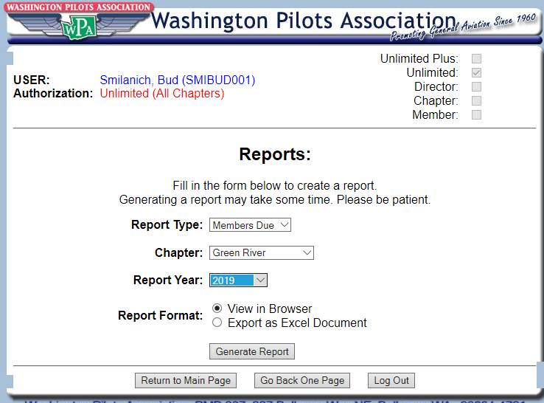
Members Due Report – A Great Way
To Contact Past Due Members

Slide 22
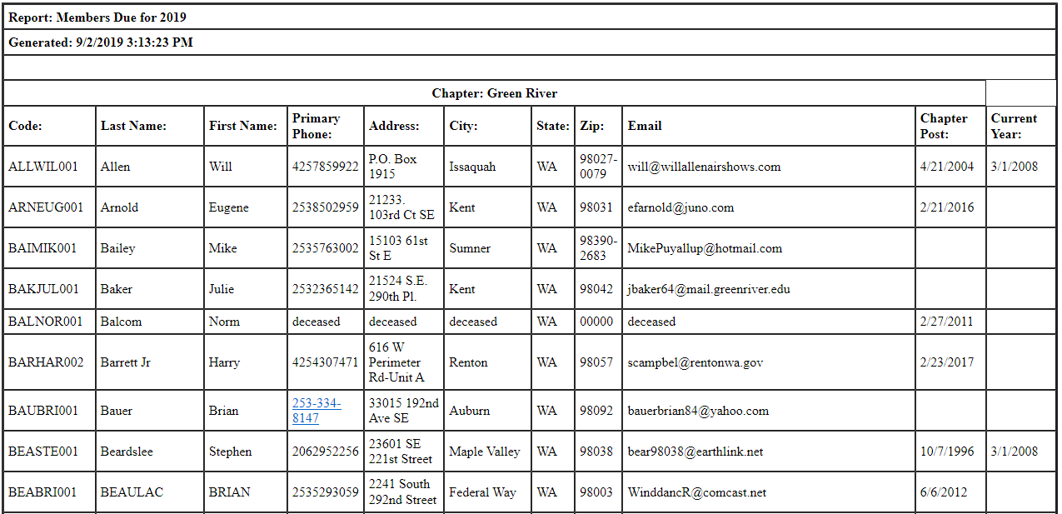
Members Due – Lots of Good Info Here

Slide 23
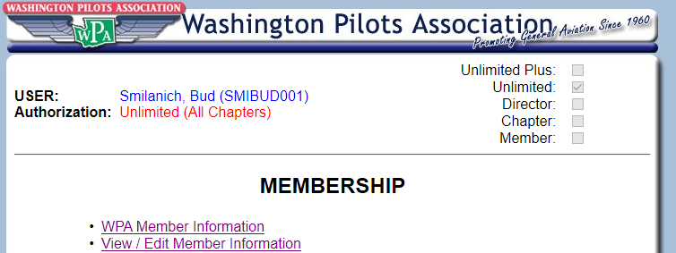
View/Edit Individual Member’s Info

Slide 24
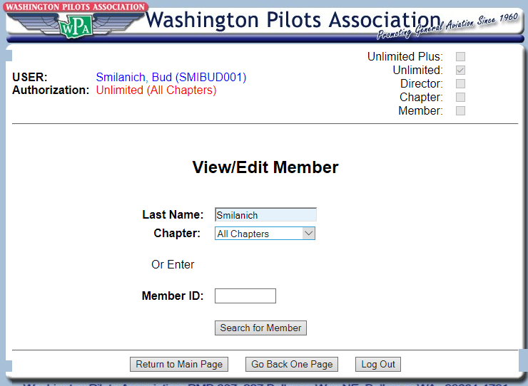

Slide 25
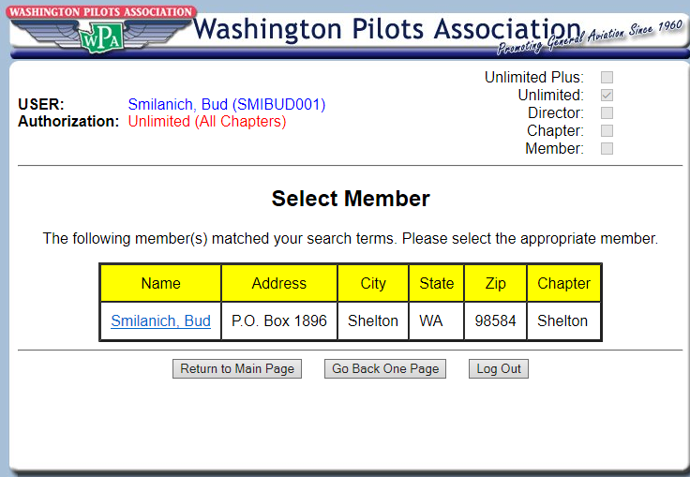
Just Click on
The Name

Slide 26
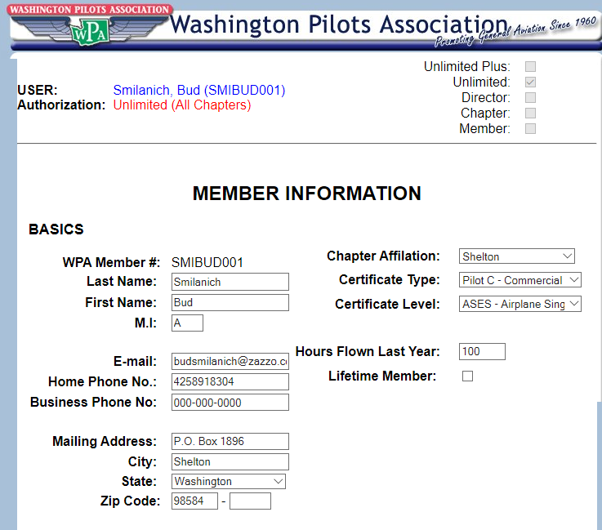
VERY IMPORTANT!
It Looks Like You Can Change
Chapter Affiliation Here –
BUT You CAN’T. Because of the Chapter/State $ Split, Chapter Affiliation Follows the Money – ONLY At Member Sign-Up/Re-Up
Scroll Down to See the Next Pages and SAVE

Slide 27
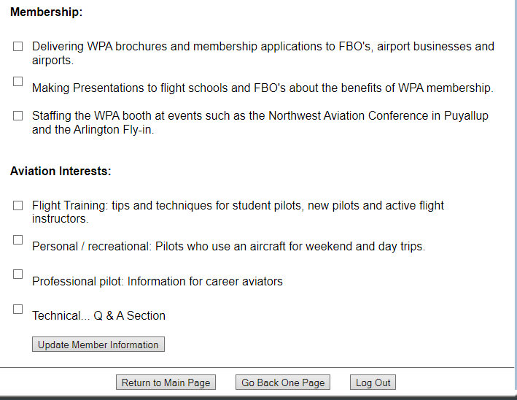
Be Sure to Scroll Down and
Hit the “Update” Button

Slide 28
Mission Statement
To Advance and Protect the Interests of General Aviation in Washington State Through Advocacy, Outreach, Education, and Social Activities
Questions? Need Assistance? Contact:
Bud Smilanich
budsmilanich@zazzo.com 425-891-8304

